Slide 1
Heart Disease prediction
Reed Foster, Jason Brooner, and Bret Hoyman

Slide 2
AGENDA
Problem
Dataset
Solution
Analyzations
Summary
Detailed plan of your solution and how you determined your solution approach. • Overview of solution modules and functions, and Python libraries employed in your code solution.

Slide 3
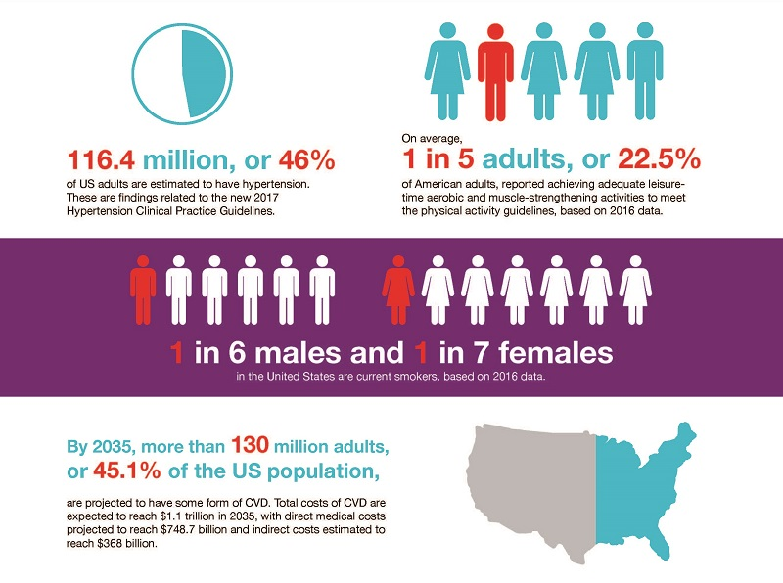
Problem
These are very alarming statistics. Many people are aware that heart disease is a thing but are not aware of the things that can contribute to a person developing the disease.

Slide 4
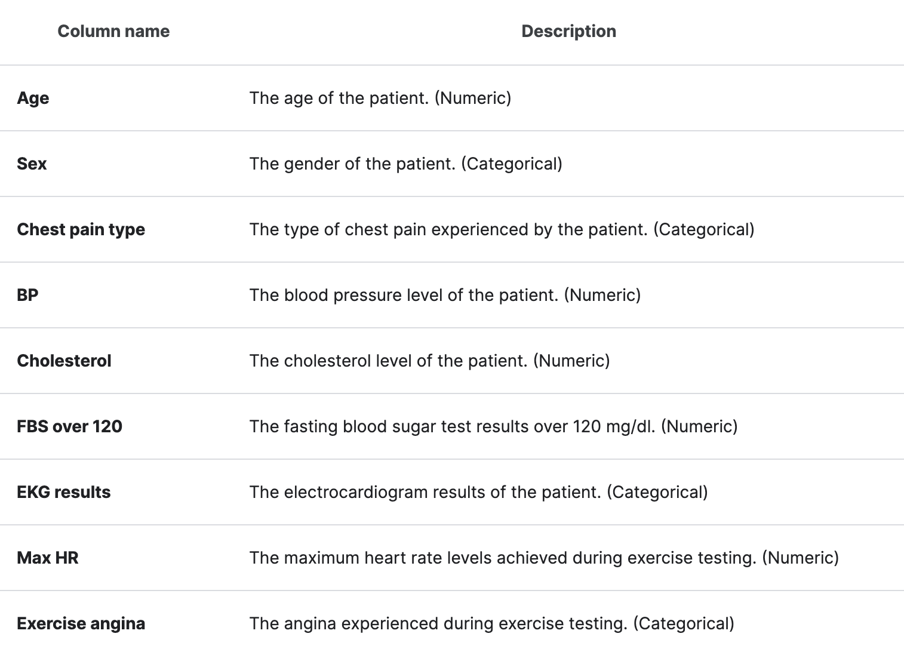
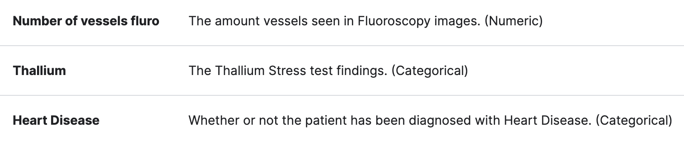
DATA set
Data set: https://www.kaggle.com/datasets/thedevastator/predicting-heart-disease-risk-using-clinical-var?resource=download
- Provides vital insight in the relationship between risk factors and cardiac health.
- This dataset contains 270 case studies of individuals classified as either having or not having heart disease based on multiple factors.
- Each patient is identified by 13 independent predictive variables.

Slide 5
Solution
Through our analysis on this data set, we have identified possible solutions for people to avoid heart disease. There is not a completely accurate solution as every case is affected differently, but through the dataset and our analysis, we have found things that people can work on to avoid heart disease.
Integrated Matplotlib, Numpy, Pandas, and sklearn.linear_model to perform and export graphical analyses that would represent our findings in physical form.

Slide 6
Analyzations
Cholesterol Age/Gender High Max Heart Rate Linear Regression
Does high cholesterol correlate with heart disease prevalence?
Does a person’s specific age and gender correlate with heart disease prevalence?
Does a high max heart rate correlate with heart disease prevalence?
What other factors correlate with heart disease prevalence?
Notes:
In terms of specific analyzations we focused

Slide 7
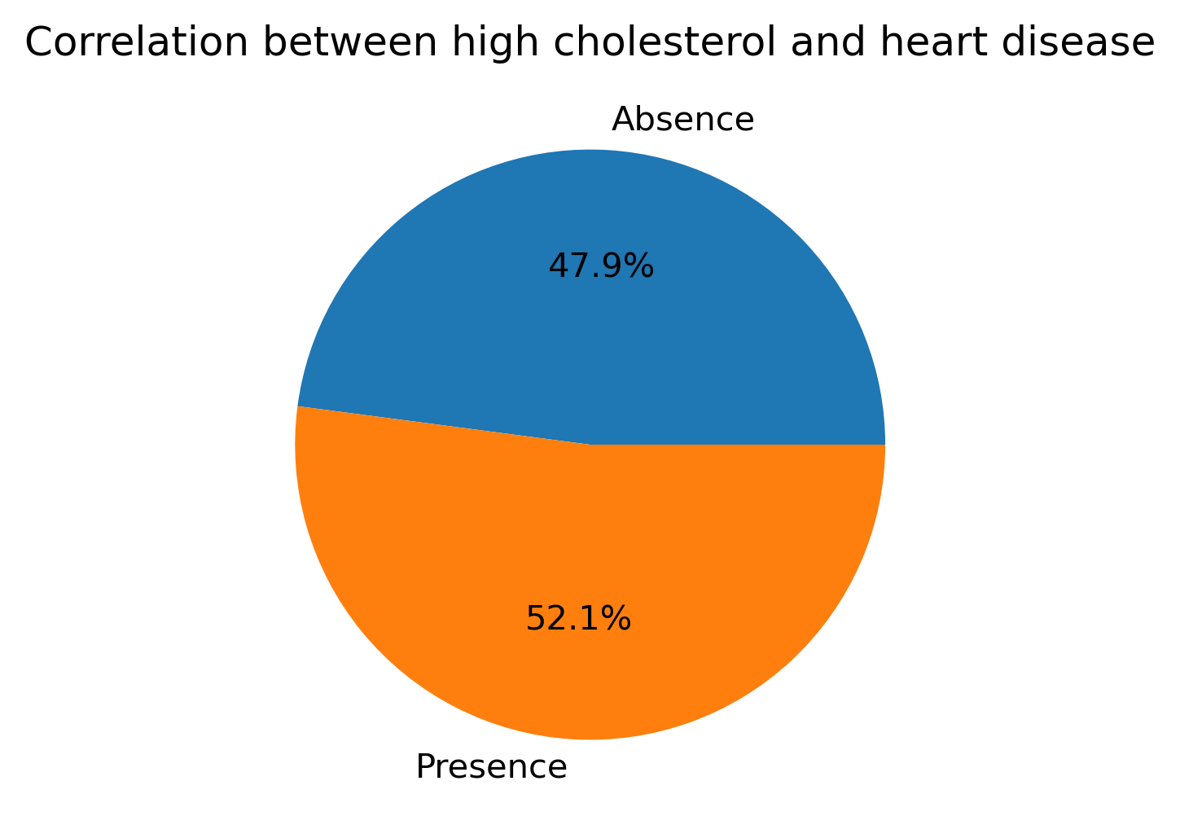
Cholesterol

Slide 8
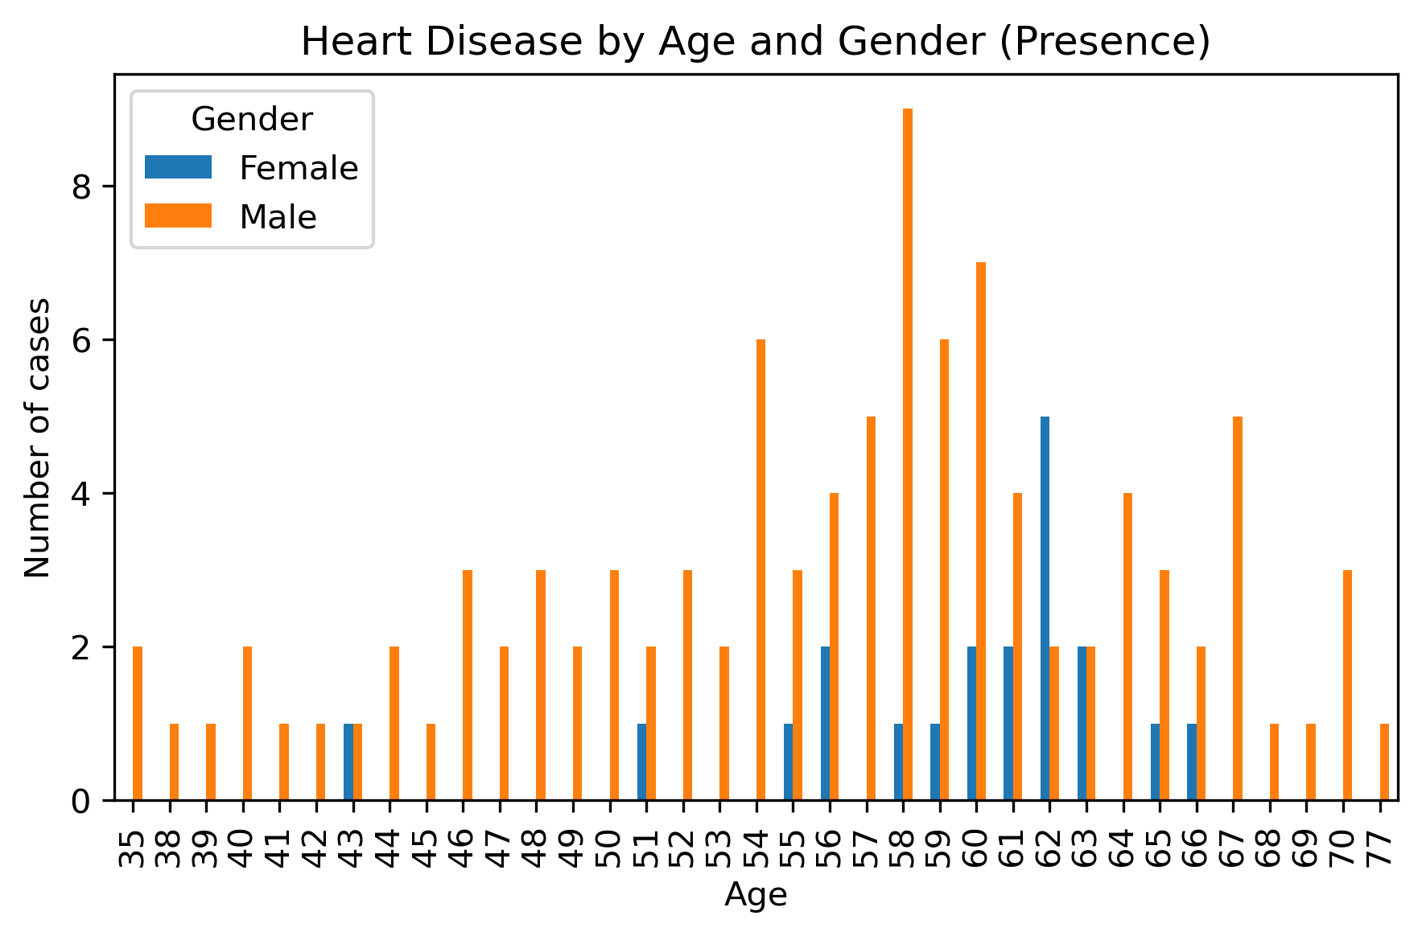
Age/Gender

Slide 9
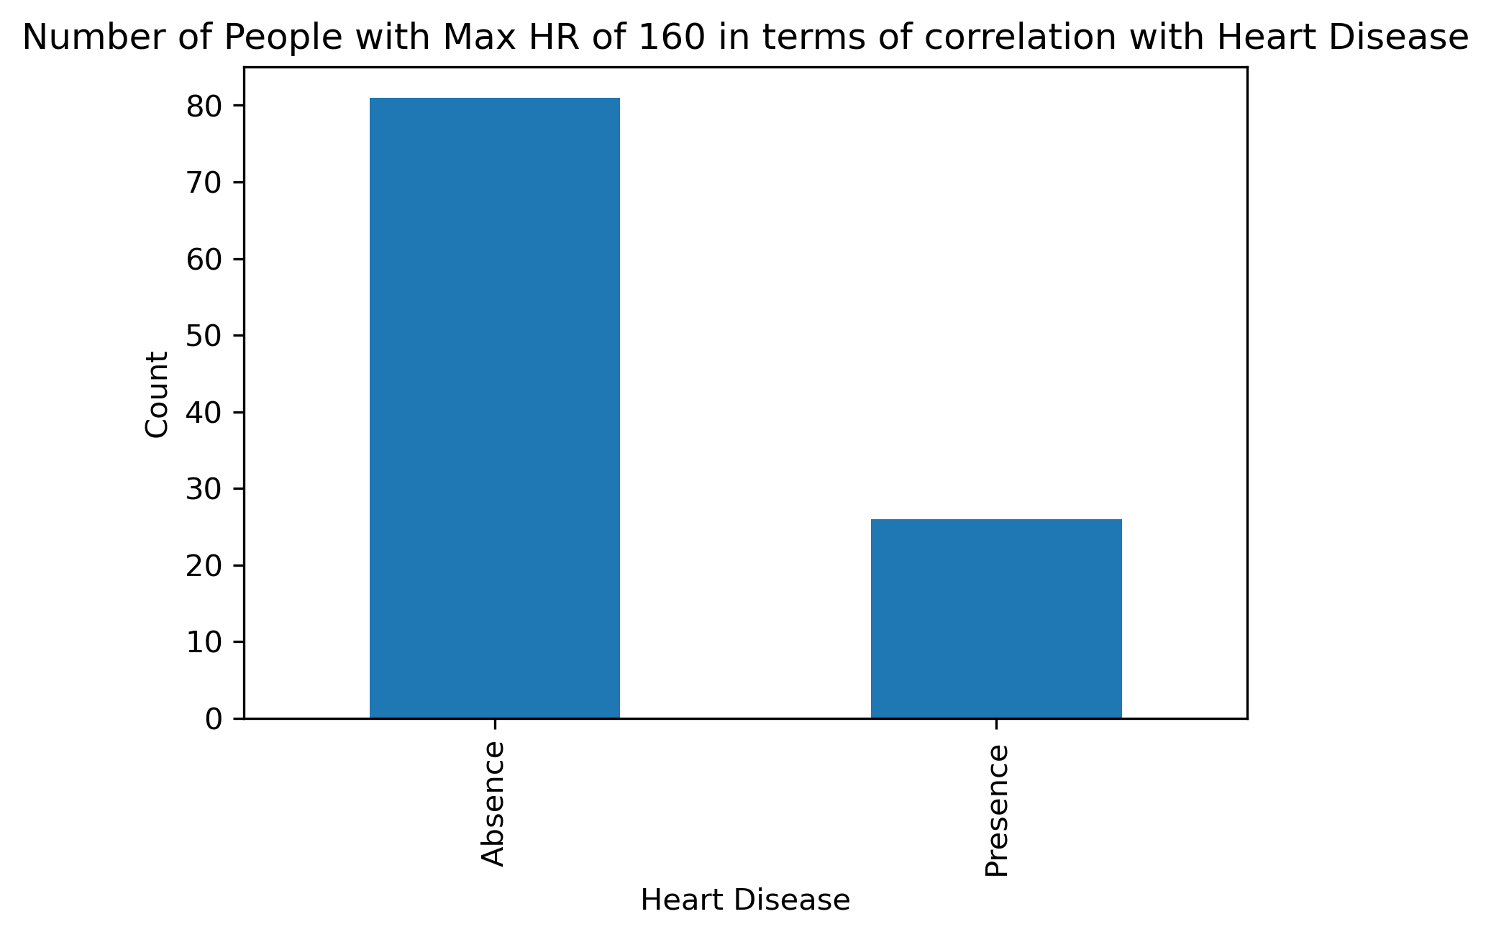
High Max heart rate

Slide 10
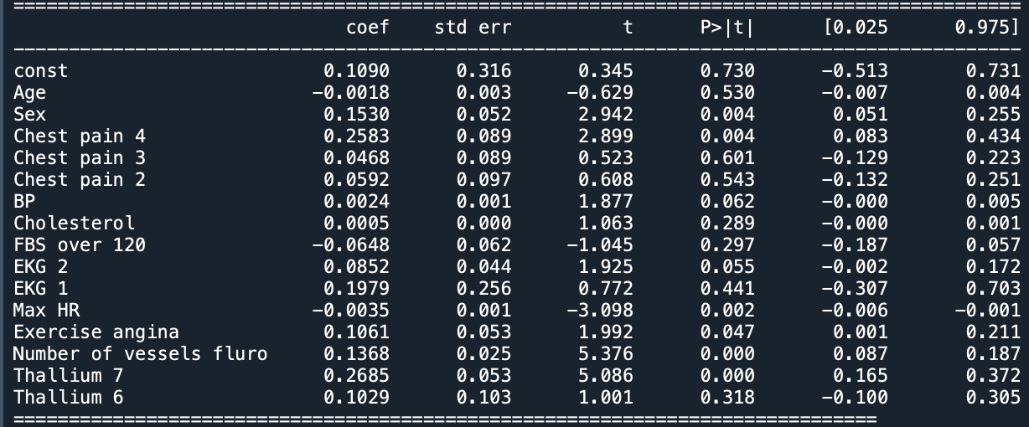
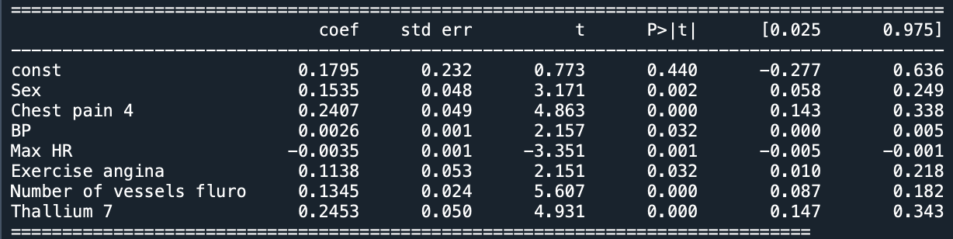
Linear regression
Regression Analysis
Parsimonious Model

Slide 11
Summary
Cholesterol
Decently high correlation of people with cholesterol levels over 240 mg.
Age/Gender
Graphical representation indicates heart disease presence reaches peak at the late 50s and early 60s, however men presented heart disease more often.
High Max Heart Rate
There does not seem to be a significant correlation with max heart rates greater than or equal to 160.
Linear Regression
The following independent variables are statistically significant in the presence/absence of heart disease: Sex, Chest Pain type 4, Blood Pressure, Max Heart Rate, Exercise Angina, # of Fluro Vessels, and Thallium level 7.
Notes:
This is good information to keep in mind as we all work towards living a healthy and successful life.

Slide 12
THANK YOU For listening

